Slide 1
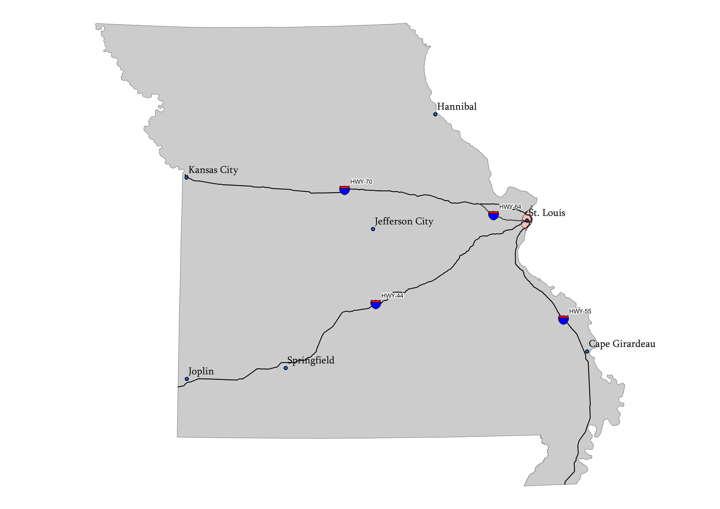
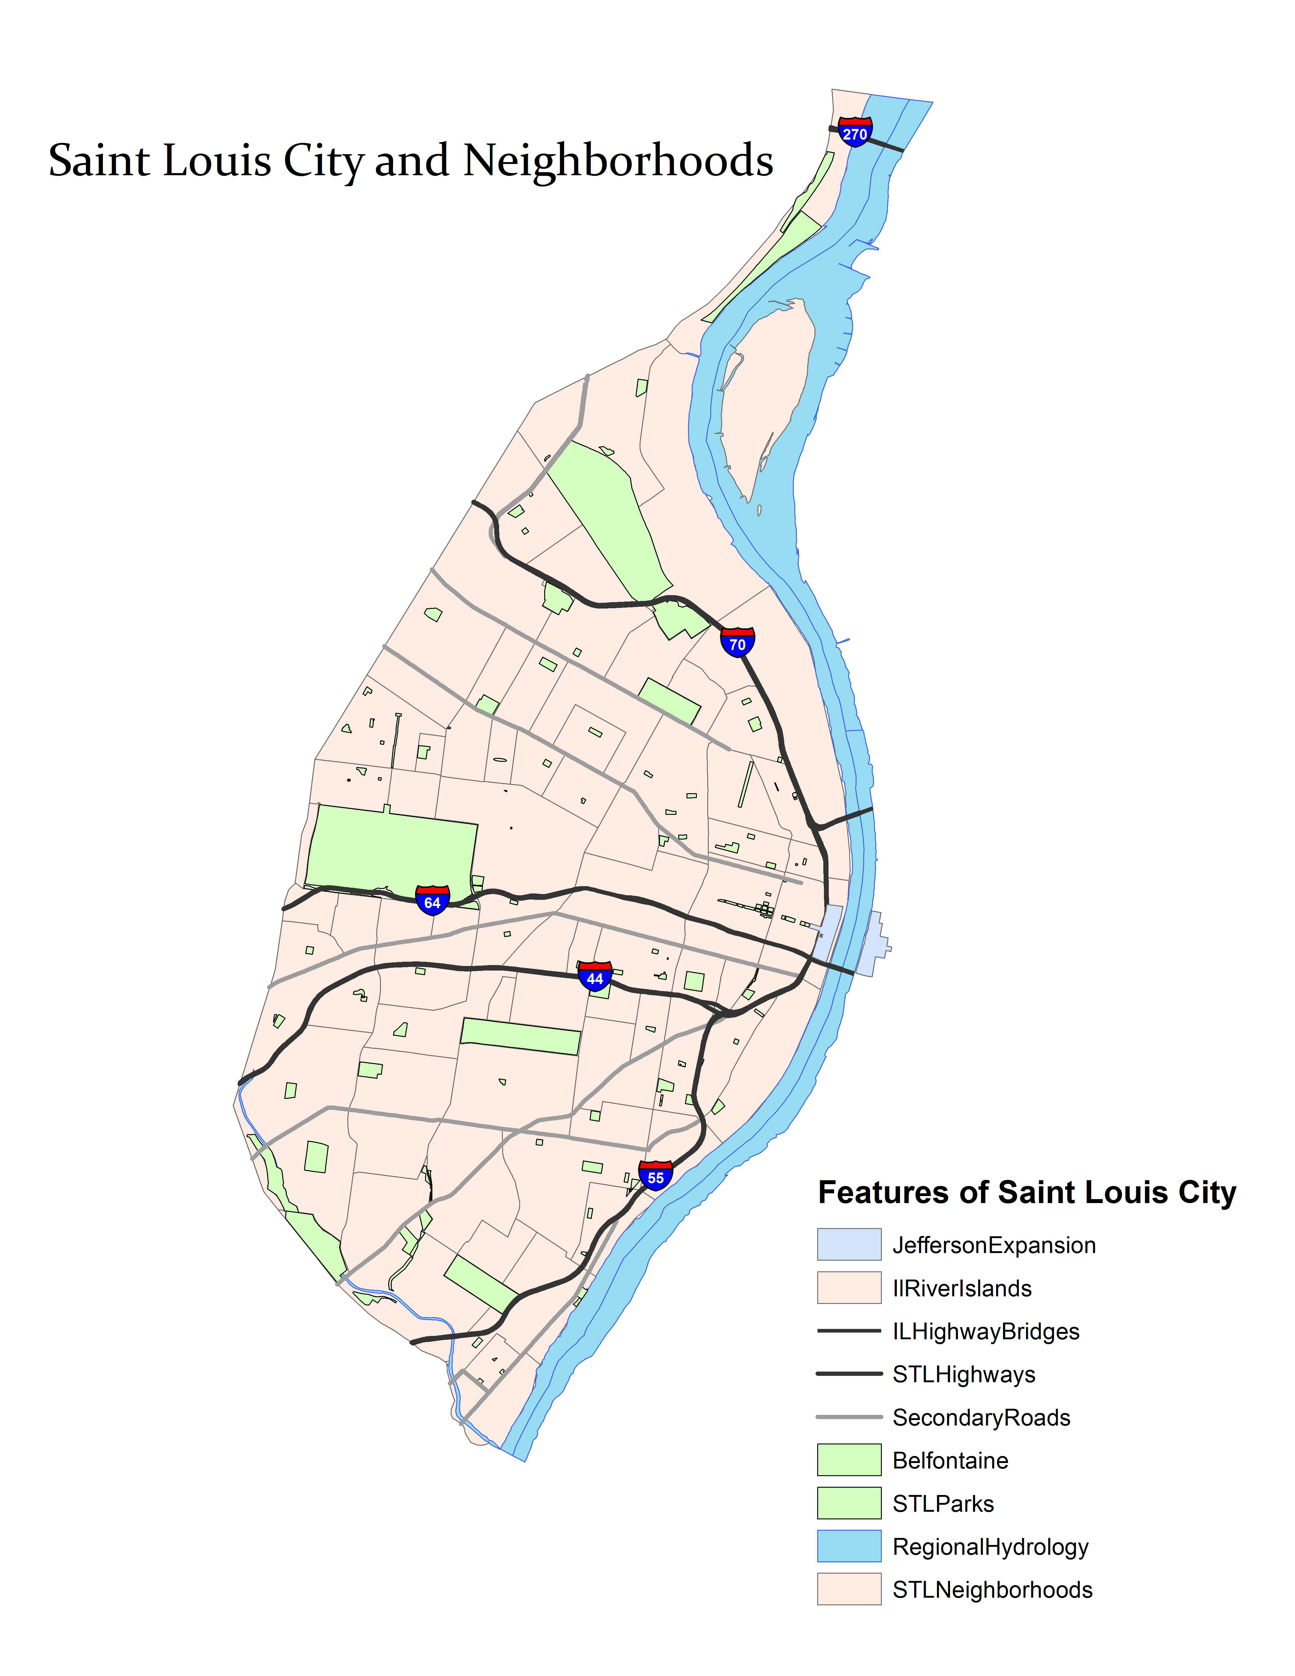
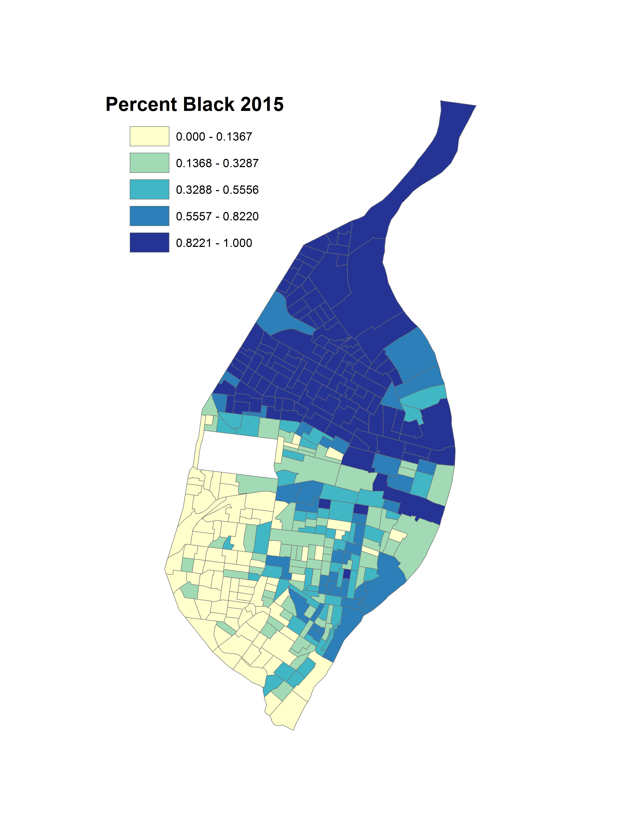
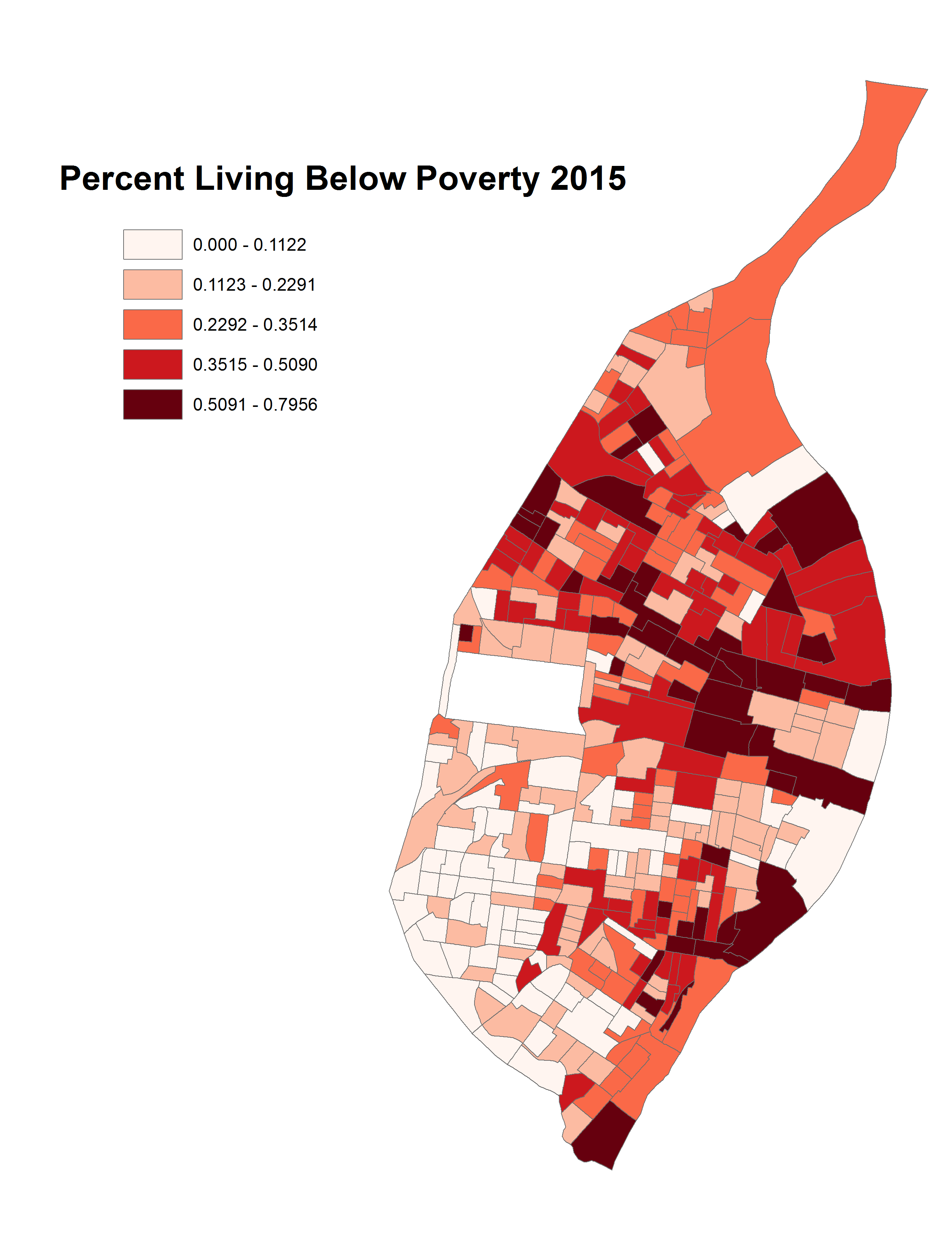
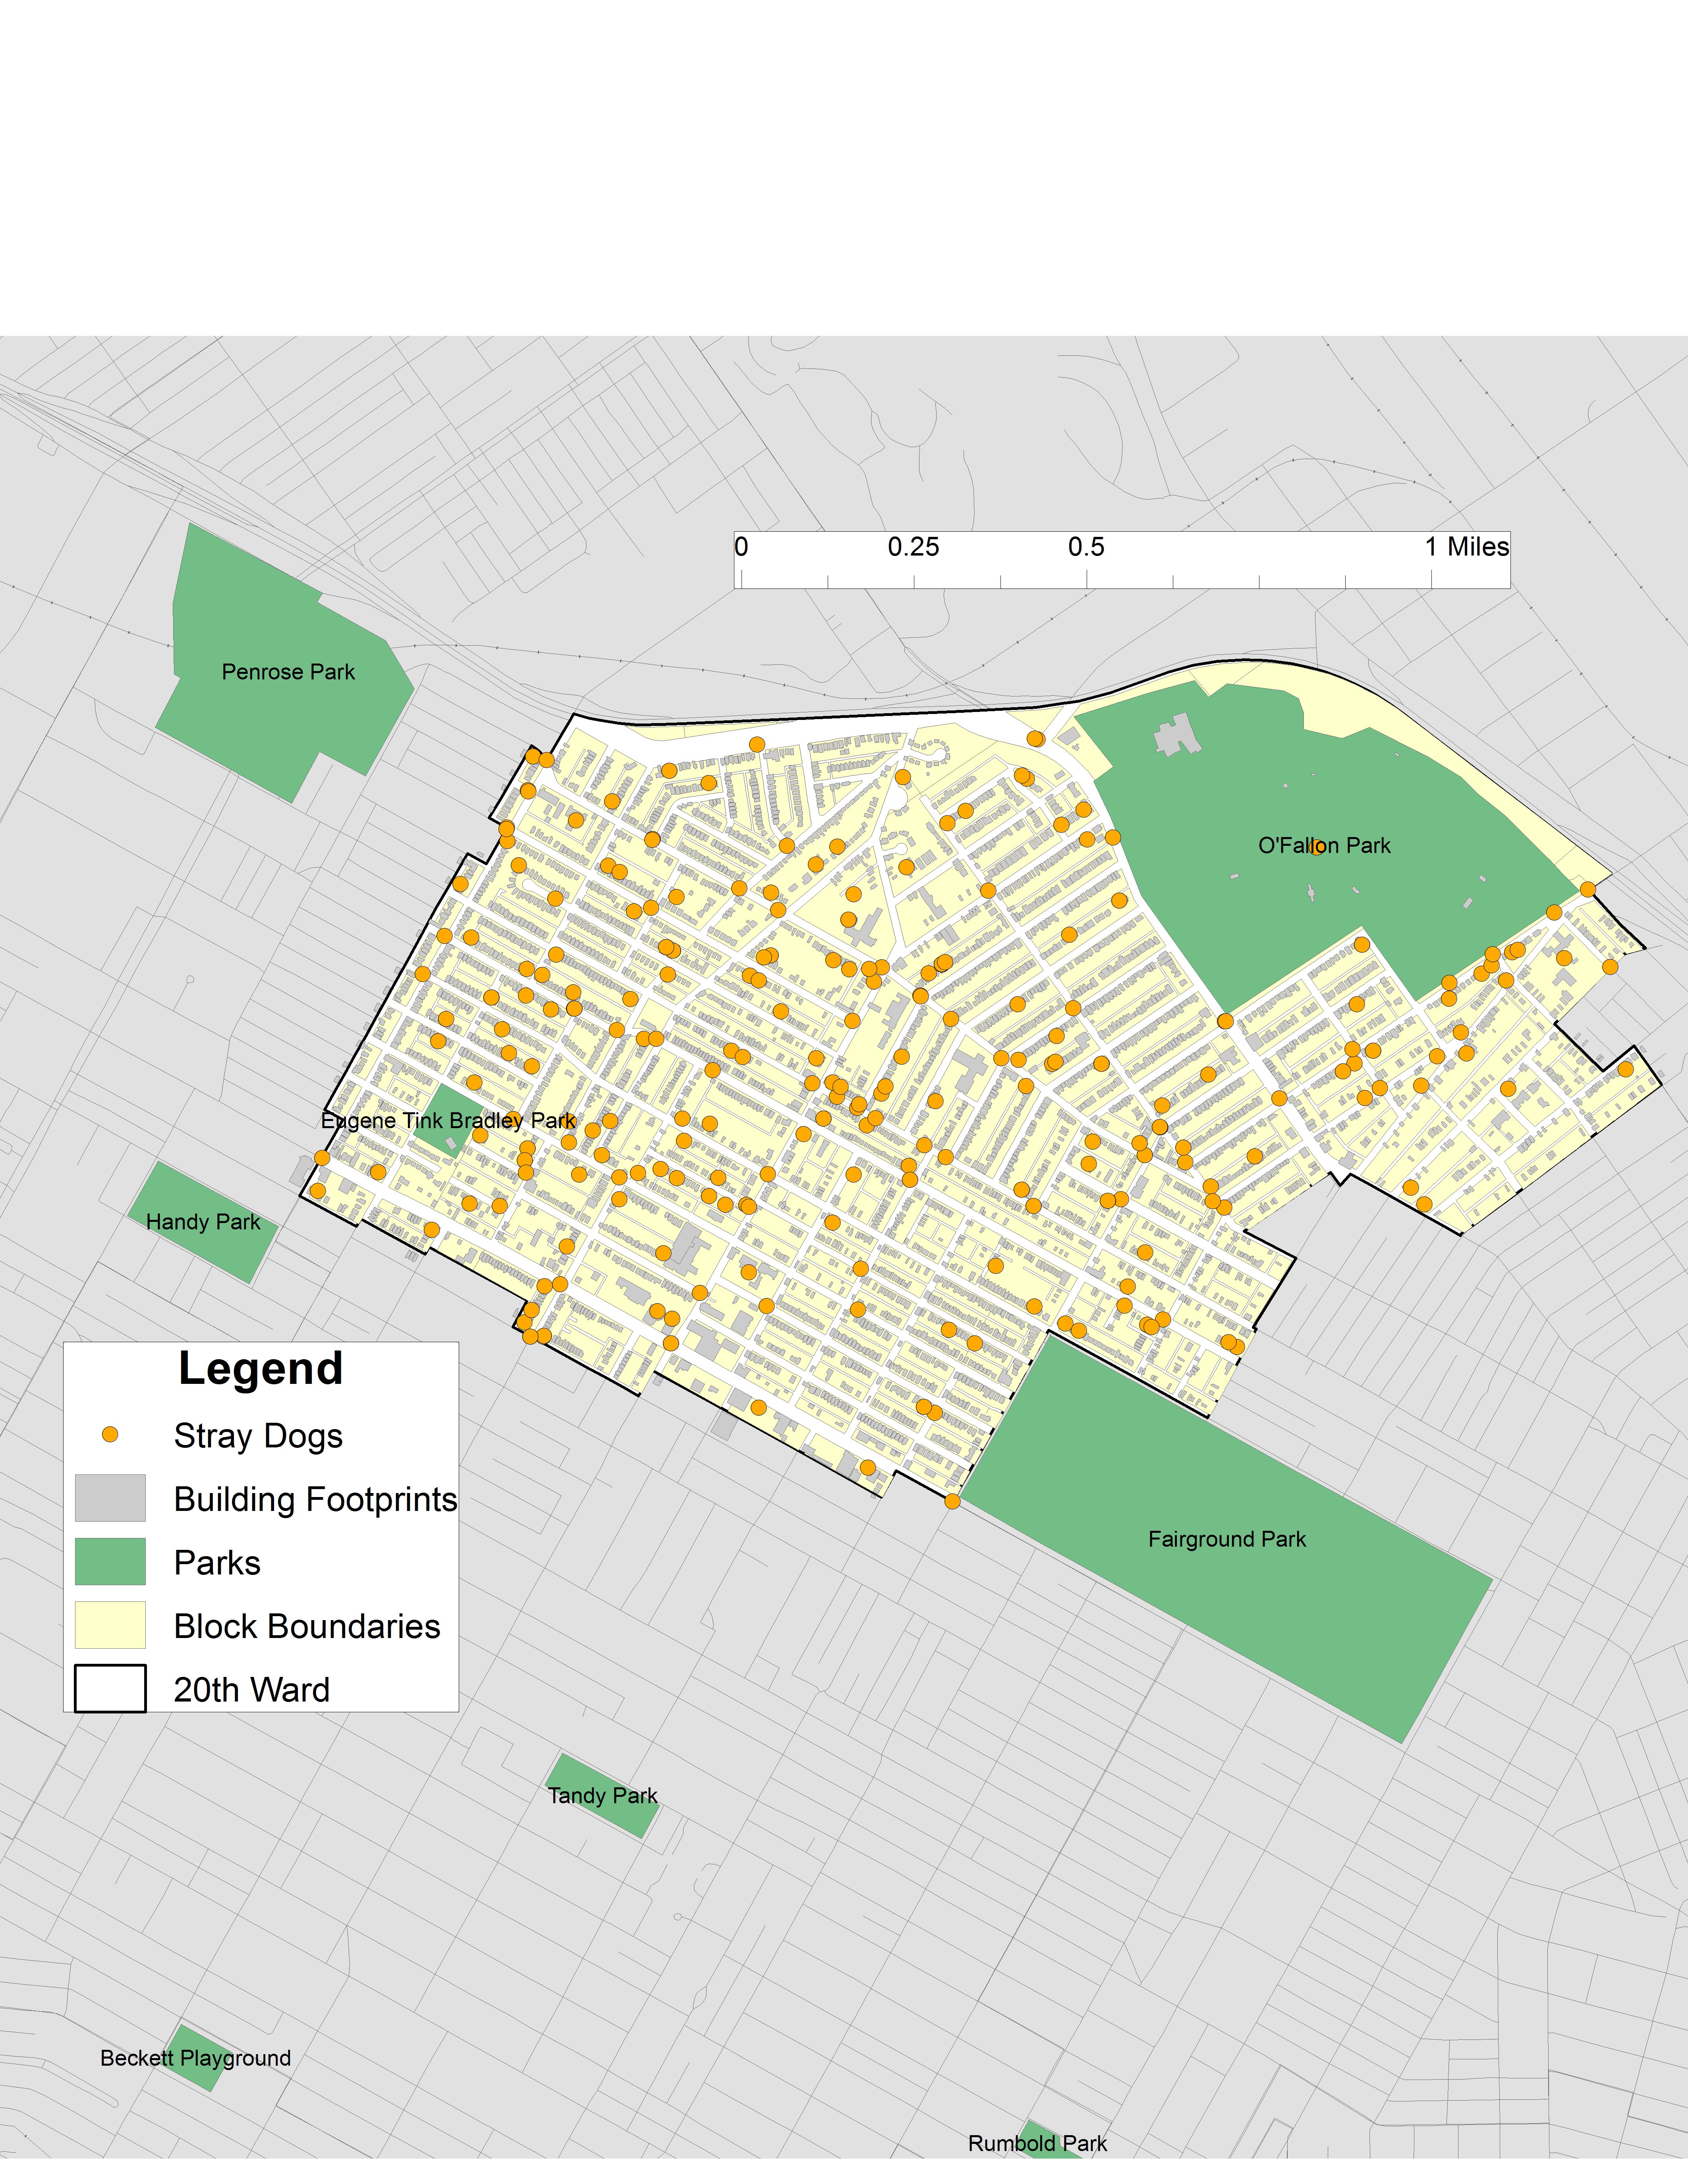
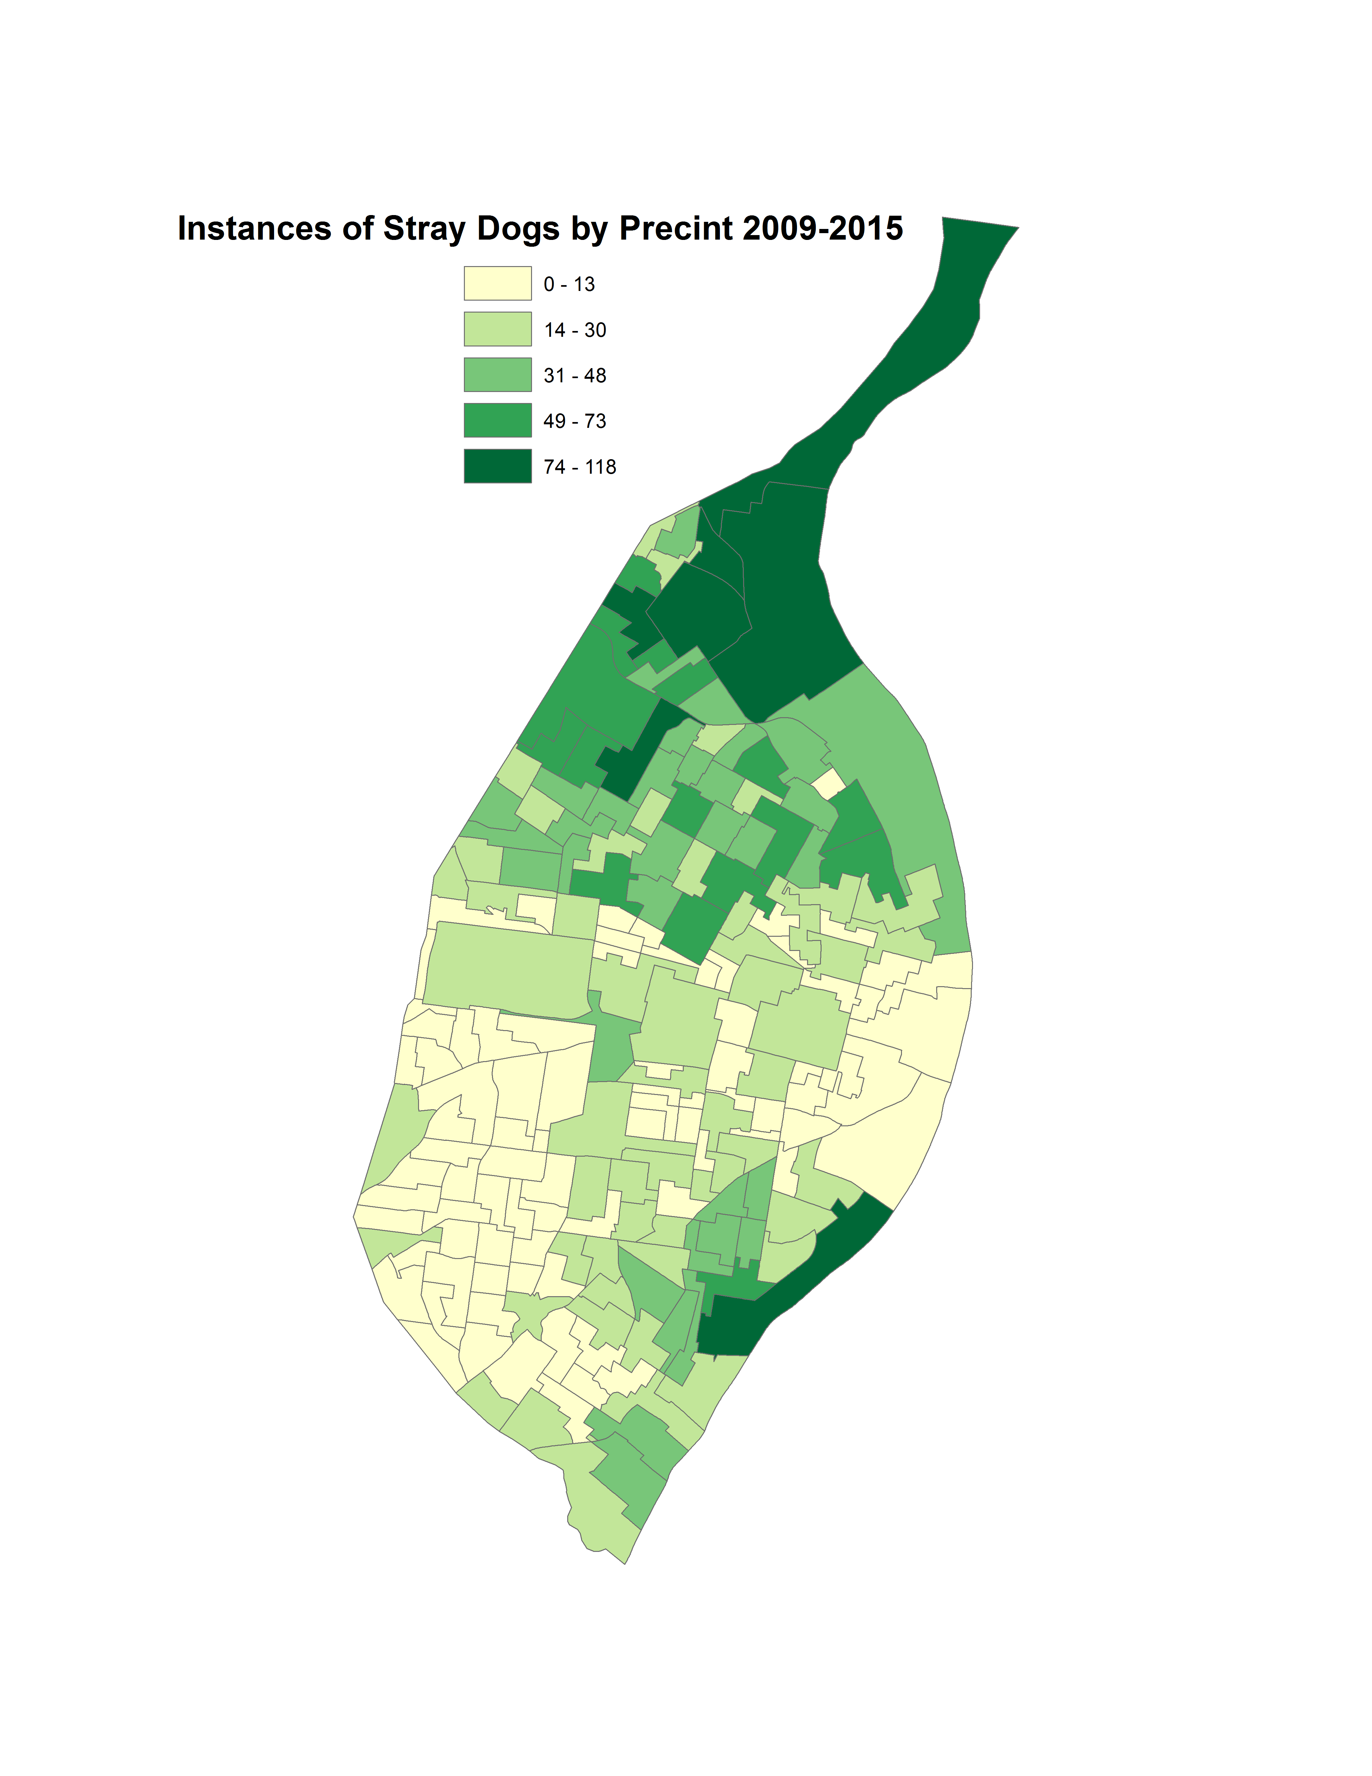
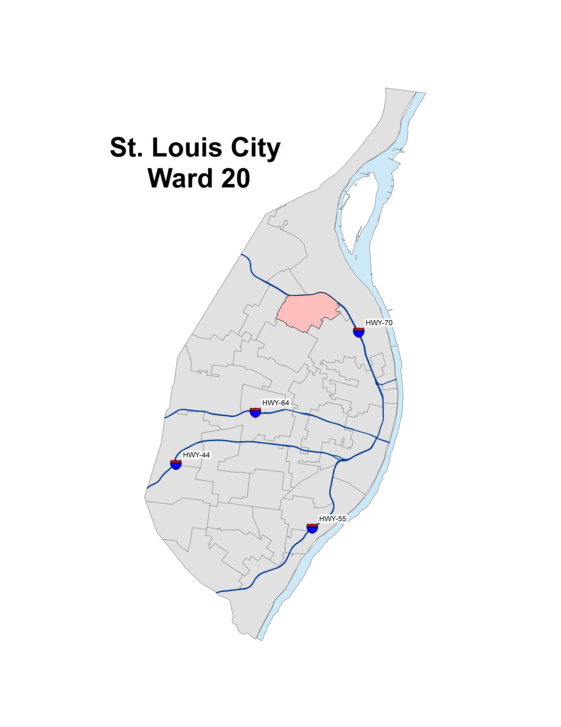
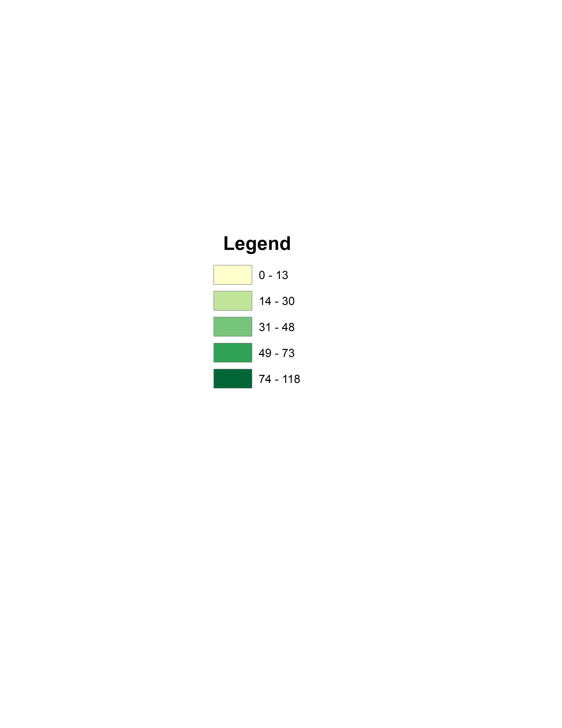
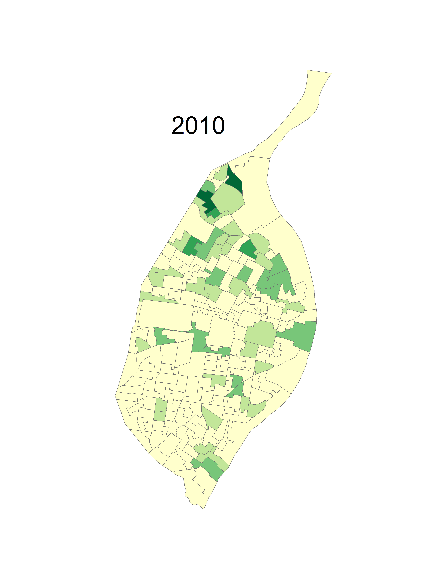
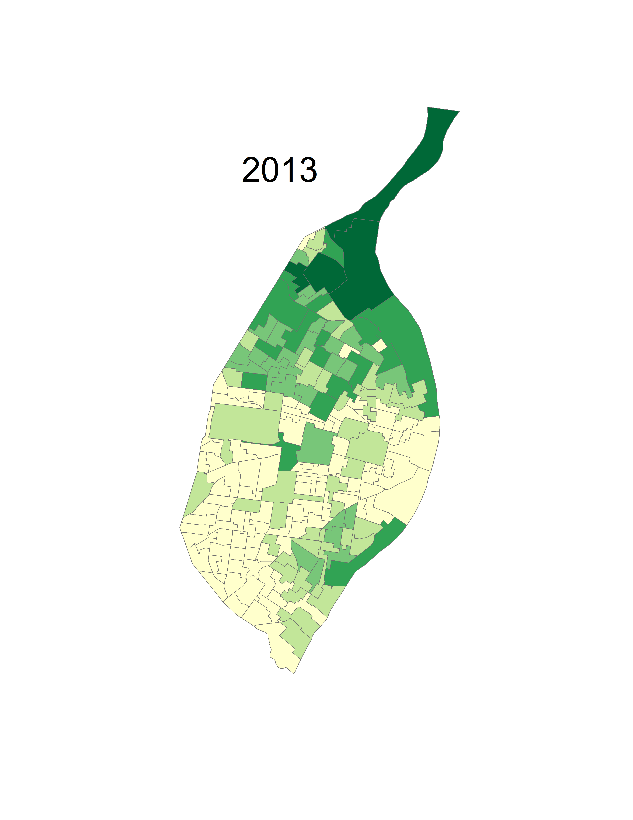
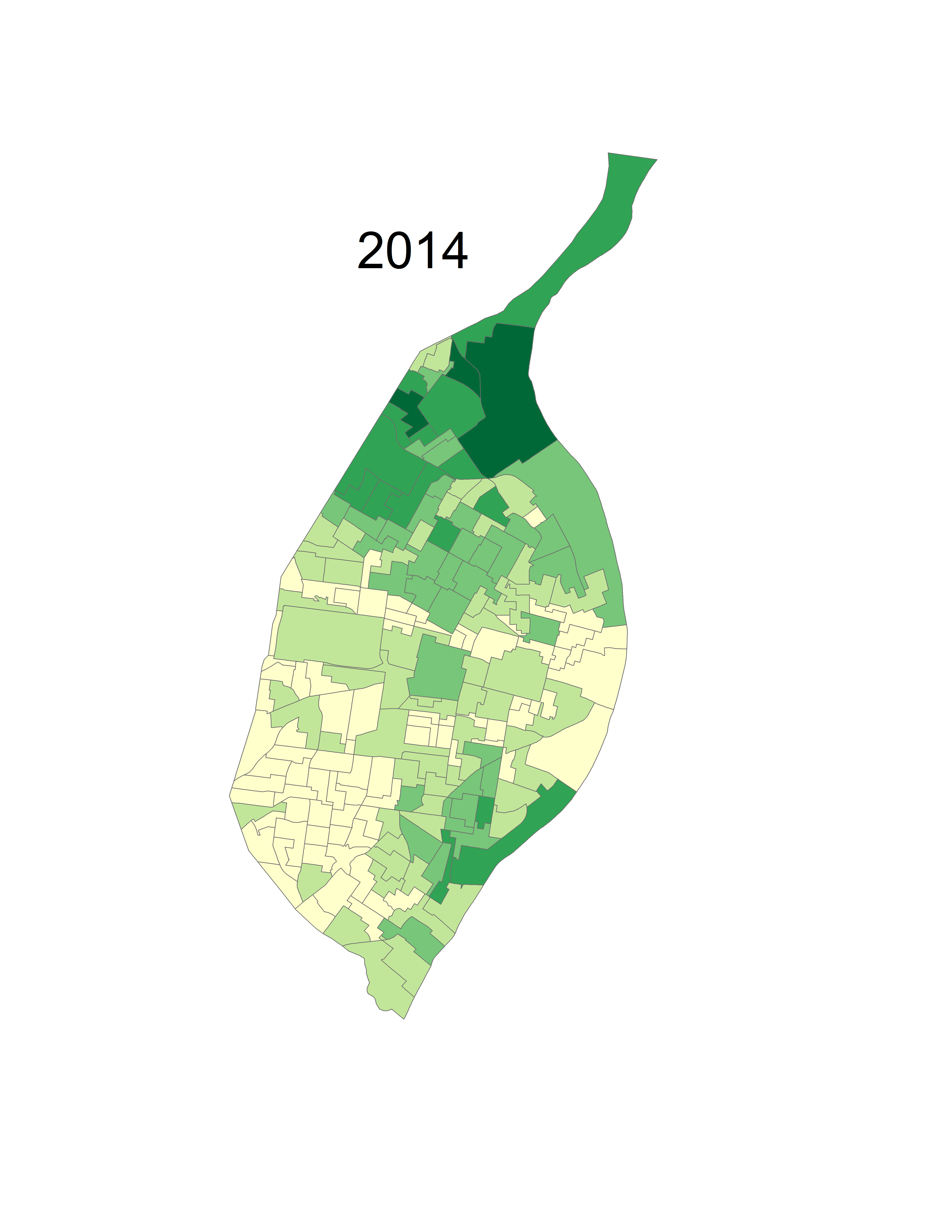
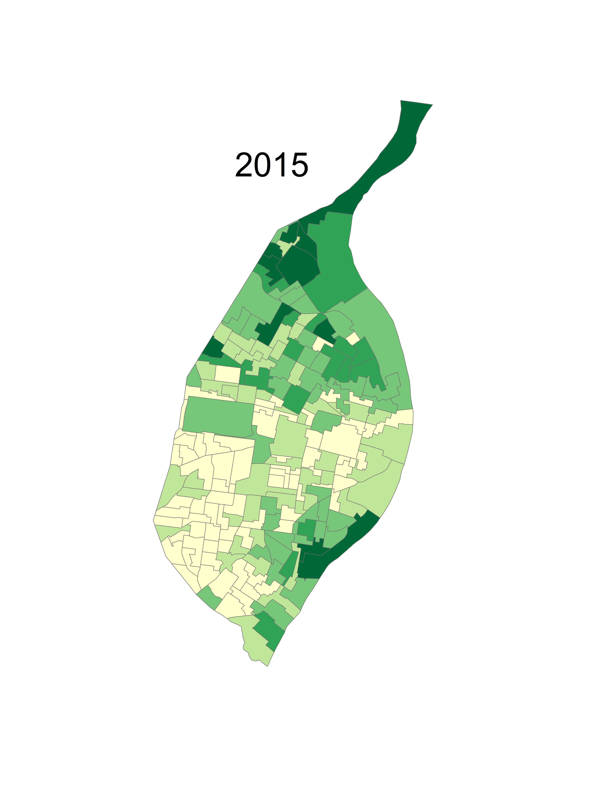
Stray Dogs in the City of St. Louis
Carter Hanford – Intro to GIS
City of St. Louis
Percent Black 2015
Percent Living Below Poverty 2015
Map 2:
Reference map of St. Louis 10”x7.5”
Projected Coordinate System: UTM Zone 15N
Introduction
The Citizen’s Service Bureau (CSB) is an organization that collects and distributes data in the city of St. Louis. Citizens can submit requests about various kinds of spatial data that will be recorded into the CSB database. Data is then organized into groups, or departments, and then distributed to the public in an online repository.
The maps represented were constructed using CSB data from 2009-2012, and represent the instances of stray dogs in the city of St. Louis. When citizens submit a request regarding a stray dog in the area, the CSB records those requests into point data. The choropleth maps represent the amount of requests, or instances, of stray dogs by voting precinct.
Stray dogs may be linked to lower poverty areas because of what it takes to manage a dog. Similarly, since poverty and race are related by area, the instances of stray dogs in an area may not only be linked to poverty, but also to race. The maps represented offer a comparison between the stray dogs, poverty, and race in the city of St. Louis.
Stray Dogs by Precinct 2009-2015
Instances of Stray Dogs, Ward 20
Data & Methods
Data obtained for use in this project came from various different data sources. The CSB provided data representing different requests in the city. The dataset involved every request category in the city, so it was cleaned to remove certain variables, instances of missing data, and duplicate data. After cleaning, there were 4,666 instances of stray dog data, which are all represents on the maps.
Demographic data was obtained from the American Community Survey (ACS) 5-year estimate. The Data was cleaned using Rstudio to represent poverty and race levels in the city of St. Louis.
Spatial data was obtained using the 2016 U.S. Census Bureau, cleaned by dropping unnecessary variables, then divided into the city boundary, block groups, wards, and voting precincts of the city of St. Louis.
All maps were generated in ArcMap using the data listed above.
Discussion
Stray dog requests seem to follow a similar pattern to race and poverty. The maps indicate that more instances of stray dogs were located in areas with higher levels of poverty and a higher percentage of black population. In the northern wards of the city, the shading of all three maps are identical, indicating that the number of stray dogs is directly proportional to the level of poverty and black population. Inversely, the south-western wards of the city have low instances of stray dogs. These wards also have low levels of poverty, and a lower black population. Overall, stray dog instances seem to directly follow trends of poverty and race in the city of St. Louis.
Stray Dog Instances by Precinct Over Time
Carter Hanford
Saint Louis University
SOC-4650 – Intro to Geographic Information Science
Spring 2018
*No data for 2009, 2011, 2012
Projected Coordinate System: NAD 1983 StatePlane Missouri East FIPS 2401 (US Feet)

